Slide 1
FHWA Crash Modification
Factors Clearinghouse
Karen Scurry – FHWA Office of Safety
Daniel Carter – UNC HSRC
Shawn Troy – NCDOT
CMF Clearinghouse Webinar, 12/13/12

Slide 2
Introduction
What is the CMF Clearinghouse?
What is the purpose of the Clearinghouse?
  Provide CMFs to users
  Provide information and education on how to use CMFs
  Link to other CMF resources
Why are we here?
Housekeeping

Slide 3
Agenda
What is a CMF?
Where does the information come from?
Searching on the CMF Clearinghouse
Interpreting search results
Using search results
North Carolina example
Study details
Demonstrations
  Searches
  User questions/scenarios
Notes:
KYS to go over housekeeping items after agenda walk-thru before handing it over to Daniel

Slide 4
What is a Crash
Modification Factor?
A CMF is a multiplicative factor
  Indicates the proportion of crashes that would be expected after implementing a countermeasure.
  Example: CMF = 0.8
CRF vs. CMF
  Crash reduction factor (20%)
  Crash modification factor (0.8)

Slide 5
What is the purpose of a CMF?
The purpose of a CMF is to estimate the number of crashes expected after implementing a countermeasure.
  Capture the greatest gain with limited funds.
    Identify most cost-effective strategy.
    Identify most cost-effective locations.
  Compare safety consequences among various alternatives.
  Compare results of new analyses with existing CMFs to check reasonableness.
  Check validity of assumptions in cost-benefit analyses.

Slide 6
Scope
Clearinghouse contains CMFs from studies that are:
  Crash based
  Focused on infrastructure characteristics or modifications (i.e., engineering)
  Focused on producing a CMF
  Explicitly reporting a CMF

Slide 7

Original Sources
Highway Safety Manual Knowledge Document
(1st edition)
FHWA Desktop Reference Guide for Crash Reduction Factors
Notes:
When the Clearinghouse was first built, it was populated mainly with CMFs from these two sources. Later, it began to be updated with CMFs from other sources.

Slide 8
Regularly Reviewed Sources
Transportation Research Board papers
Journal articles (ASCE, ITE, etc.)
Other research reports (open TRID search)
State research reports
User submitted studies

Slide 9
Critical Review Process
Purpose
  Gather details about studies and CMFs
  Evaluate quality and determine if included in Clearinghouse
Preliminary review
  Determine if study is eligible for Clearinghouse
  Gather all applicable data on the study and CMFs
Critical review
  Examine data and establish star quality rating

Slide 10
Clearinghouse Review Process
Structured but subjective process
Star rating – what it is, what it isn’t
Star quality rating criteria
(Excellent, Fair, Poor)
  Study design
  Sample size
  Standard error
  Potential bias
  Data source

Slide 11
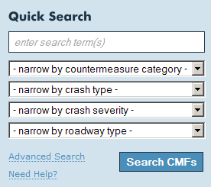
Searching on the Clearinghouse
Quick search and advanced
search
Search terms
  Match all words, match any
  words, match exact phrase
  Blank searches
Narrowing fields
  “All” returns only CMFs addressing “all” types/severities

Slide 12
Interpreting Search Results
What is displayed in the search results?
Why do some CMFs look the same?
From search results to CMF details
Missing data – dependent on study author
Excel output
HSM indications

Slide 13
Using Search Results
Factors in choosing a CMF
  Crash type and severity
  Facility type
  Star rating
  Others: AADT range, state of origin, etc.
APPLICABILITY is key
Science of CMFs course

Slide 14
Guest Speaker
Shawn Troy, NCDOT Safety Evaluation Group

Slide 15
Study Details
Details on original study
Shows all CMFs produced by the study

Slide 16
Demonstration Searches
Left turn lane installation
HAWK signal
J-turns
Bicycle lanes and superelevation

Slide 17
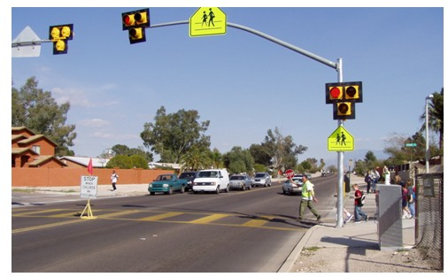
HAWK signal (pedestrian hybrid beacon)

Slide 18
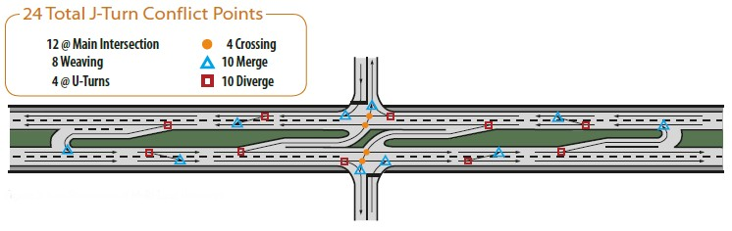
J-turn

Slide 19
Wrap up
Newsletter sign up
http://www.cmfclearinghouse.org/newsletter_signup.cfm
User feedback is important
NHI courses available
  Application of Crash Reduction Factors (course FHWA-NHI-380093)
  Science of Crash Reduction Factors (course FHWA-NHI-380094
Email certification for continuing education credit
Future webinars

Slide 20
Questions?
www.CMFClearinghouse.org
Karen Scurry, P.E.
FHWA Office of Safety Programs
609-637-4207
karen.scurry@dot.gov
Notes:
Brochure available for download
Webinar recording available on Clearinghouse website

